Slide 1
AWS Serverless Web Backend
Lecturer: Ngo Huy Bien
Software Engineering Department
Faculty of Information Technology
University of Science
Ho Chi Minh City, Vietnam
nhbien@fit.hcmus.edu.vn

Slide 2

Objectives

Slide 3

Contents

Slide 4

References

Slide 5
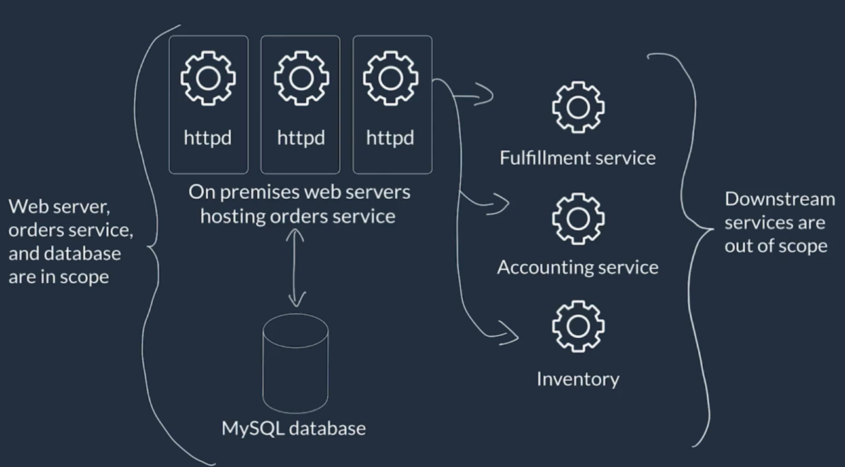
Use Case and Pain Points
Workload issue: huge traffic → failed API calls.
Scaling issue: maintenance cost, no elastic scaling.

Slide 6
Requirements
Need: performance and operational cost.
Opportunity: willing to refactor architecture and rewrite code.
Wishes: monitoring and logging.

Slide 7
Selecting a Serverless Compute Service
https://aws.amazon.com/products/compute/
AWS Lambda

Slide 8
Choosing an AWS Database Service
https://aws.amazon.com/products/databases/
Amazon DynamoDB

Slide 9
Event-Driven Architectures on AWS
Amazon SNS
Amazon SQS

Slide 10
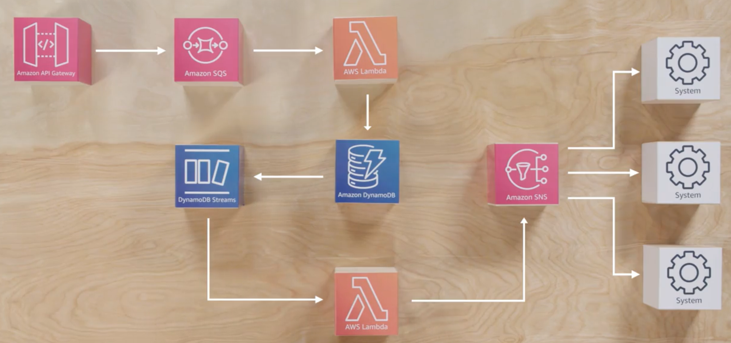
Solution Overview

Slide 11
Architecture Optimizations
Caching for Amazon DynamoDB by using Amazon DynamoDB Accelerator
AWS Lambda Power Tuning
AWS Lambda Powertools
AWS Lambda execution environment reuse

Slide 12
Building a Proof of Concept
https://aws-tc-largeobjects.s3.us-west-2.amazonaws.com/DEV-AWS-MO-Architecting/exercise-1-serverless.html

Slide 13

Thank You & See You Again

